Slide 1

Online Learning Platforms

Slide 2

Times Table Rock Stars

Slide 3
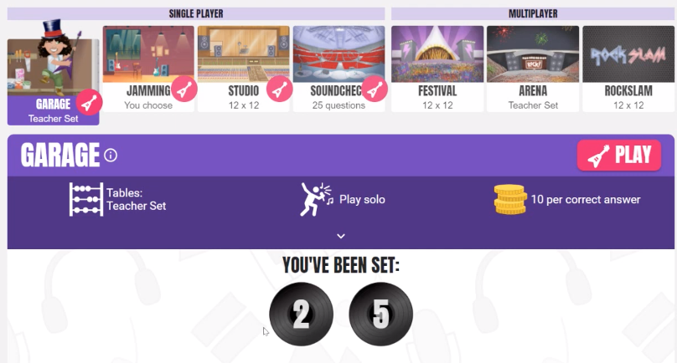
Garage
Targeted times tables set by your child’s class teacher .
Notes:
Garage mode will be set by your child’s class teacher.
This will be a targeted times table – one that your child needs to learn.
No more than 3 times tables will be set.

Slide 4
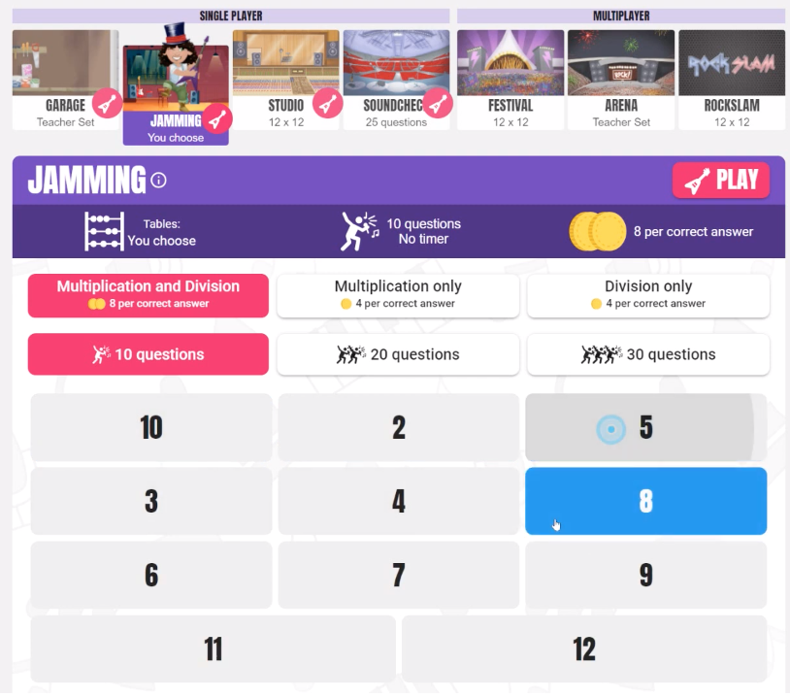
Jamming
Children can choose which table they want to practise.
Notes:
Children can choose which table they want to practise.
This is the preferred order.
Choose one time table at a time,
You can choose 10, 20 or 30 questions.
There is no timer on jamming.
You can choose multiplication only, division only or multiplication and division.

Slide 5
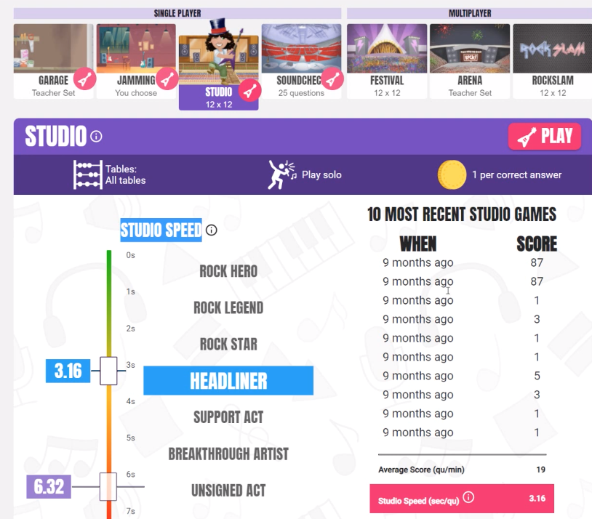
Studio
This is where your child gets their rock star status.
Notes:
This is where you get your rock star status.
It is based on your studio speed – how long it takes you to answer a question.
Most recent 10 games played. The faster you are – the

Slide 6
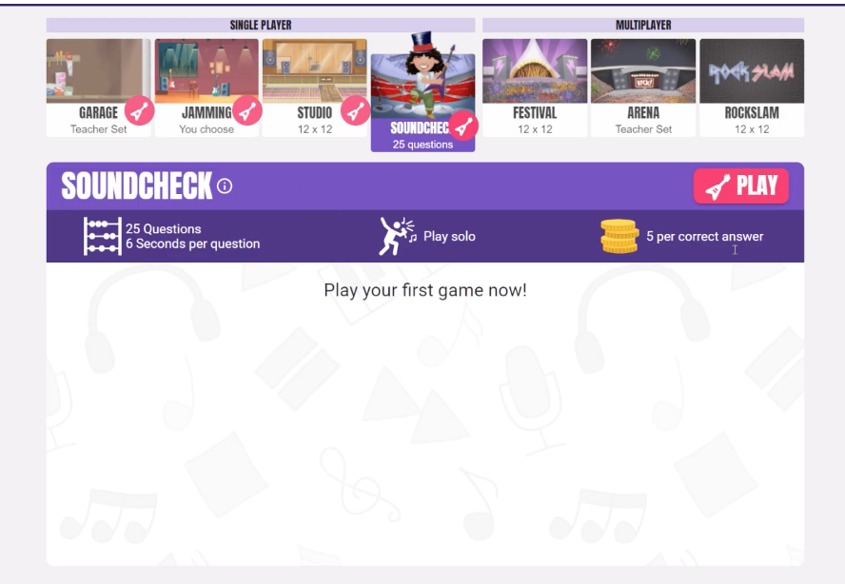
Soundcheck
25 questions – multiplication only
Notes:
25 questions – multiplication only.
6 seconds only.
This is very similar to the Times Table Check in Y4.
If you enter the answer without pressing enter it will still accept it.

Slide 7
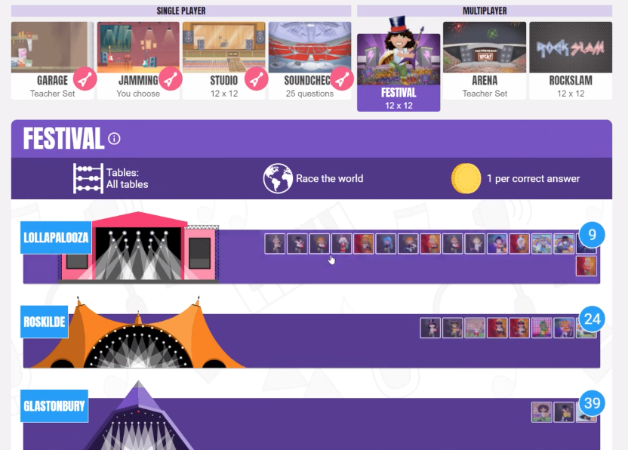
Festival
Race against other players around the world.
Notes:
Race against other players.
A new game every 15 seconds.
Last 1 miute.
Competetive.

Slide 8
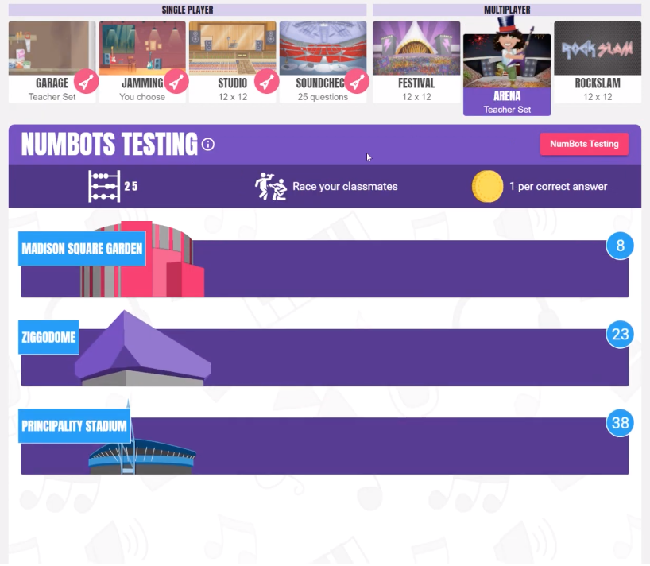
Arena
Very similar to festival apart from your child competes against children in their own class.
Notes:
Very similar to festival.
You play with children in your own class.
Same tiems tables as in the garage.

Slide 9
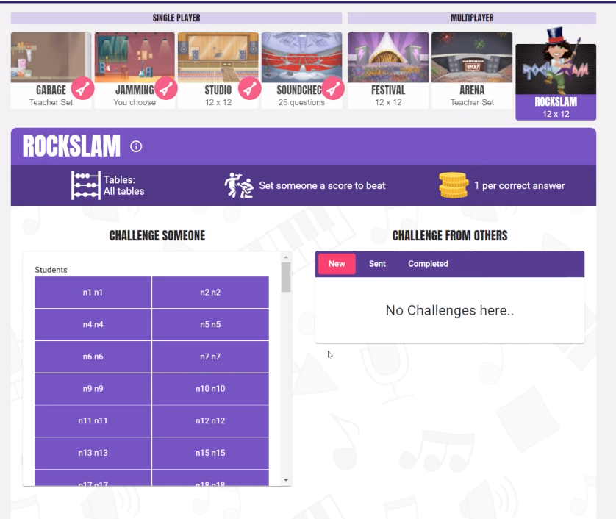
Rockslam
Your child can choose anyone in the school to challenge.
Notes:
Choose anyone in the school to play.
60 seconds to answer as many questions as you can.
Don’t need to be online at the same time,

Slide 10

Spelling Frame

Slide 11
Weekly spellings
Teachers will schedule your child’s spelling words for the week.
When curriculum words are set they aren’t always available on spelling frame.
You will find all your child’s spellings on the weekly update (KS2).

Slide 12
Tricky Word ‘List’
When your child gets a word wrong in a test, it is added to their own ‘Tricky Word’ list. They can then practise with those words they find tricky until they get them right

Slide 13
Teachers can see the results whenever their children take a test and can track the progress over time.
Teachers can see when children have logged on.
Students earn ‘Spelling Points’ by playing games and activities.

Slide 14

Purple Mash

Slide 15
What is purple mash?
Purple Mash is a whole curricular, online resource that supports children in all subject areas or topics, whilst encouraging children to love learning.

Slide 16
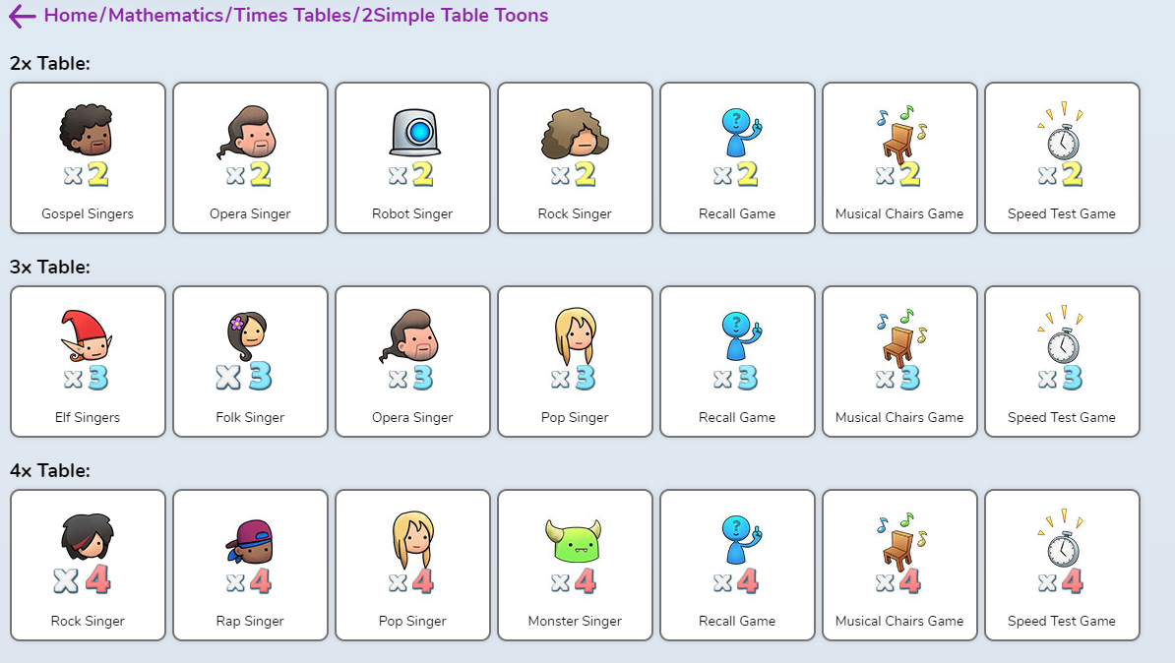
Table Toons

Slide 17
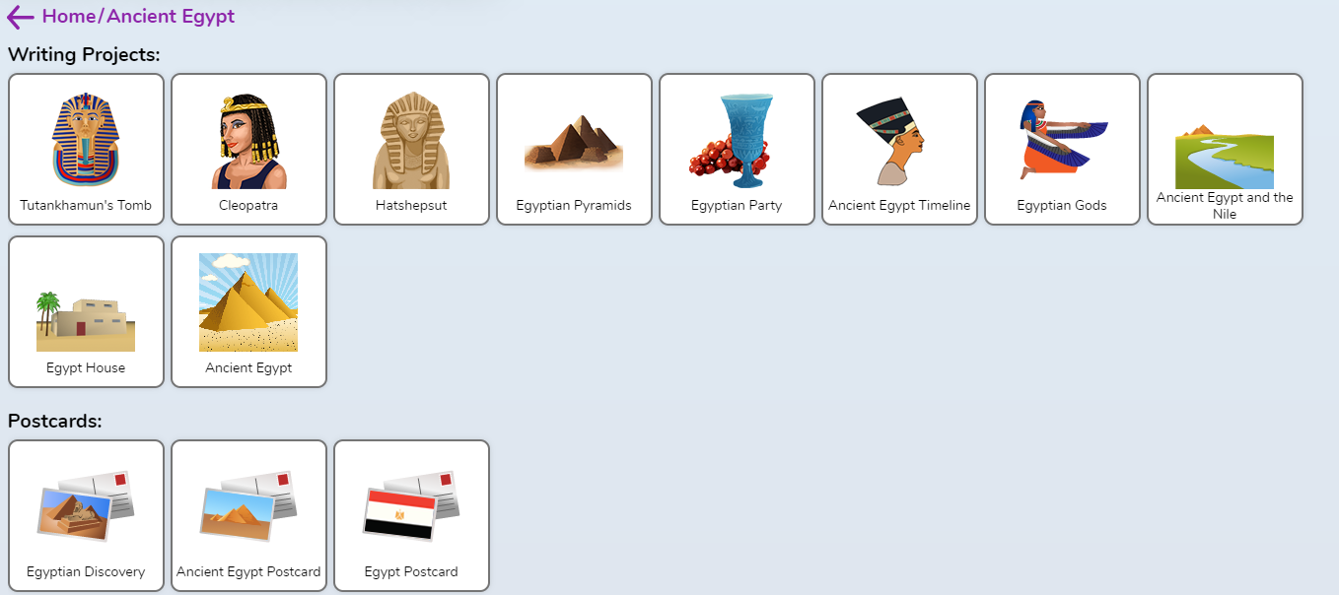
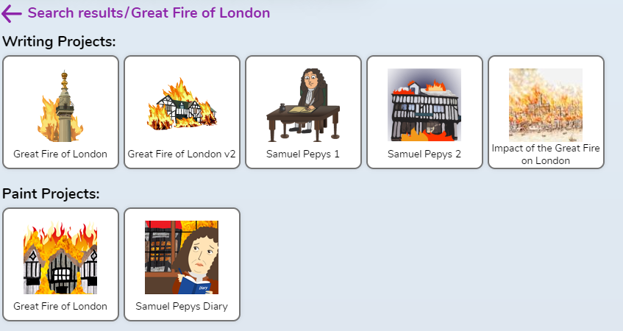

Slide 18

Numbots

Slide 19
What is it?
NumBots is all about every child achieving the “triple win” of understanding, recall and fluency in mental addition and subtraction, so that they move from counting to calculating.
Numbots focuses on automatic recall of number facts as well as developing conceptual understanding.
Little and often is the most effective practice.

