Slide 1
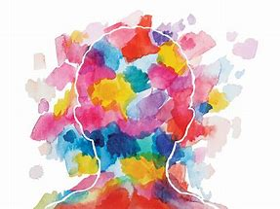



Mental Health and Wellbeing
Mrs Wilson and Miss Hutchison

Slide 2
What are we doing in school to support wellbeing?
Being mindful and thinking more about our emotions and how our bodies are feeling.
Being positive-thinking and saying positive things about ourselves.
Visualising happy places/listening to positive stories/passages.
Focusing on our breathing.
Massaging/relaxing our bodies
Stretching and moving our bodies..

Slide 3
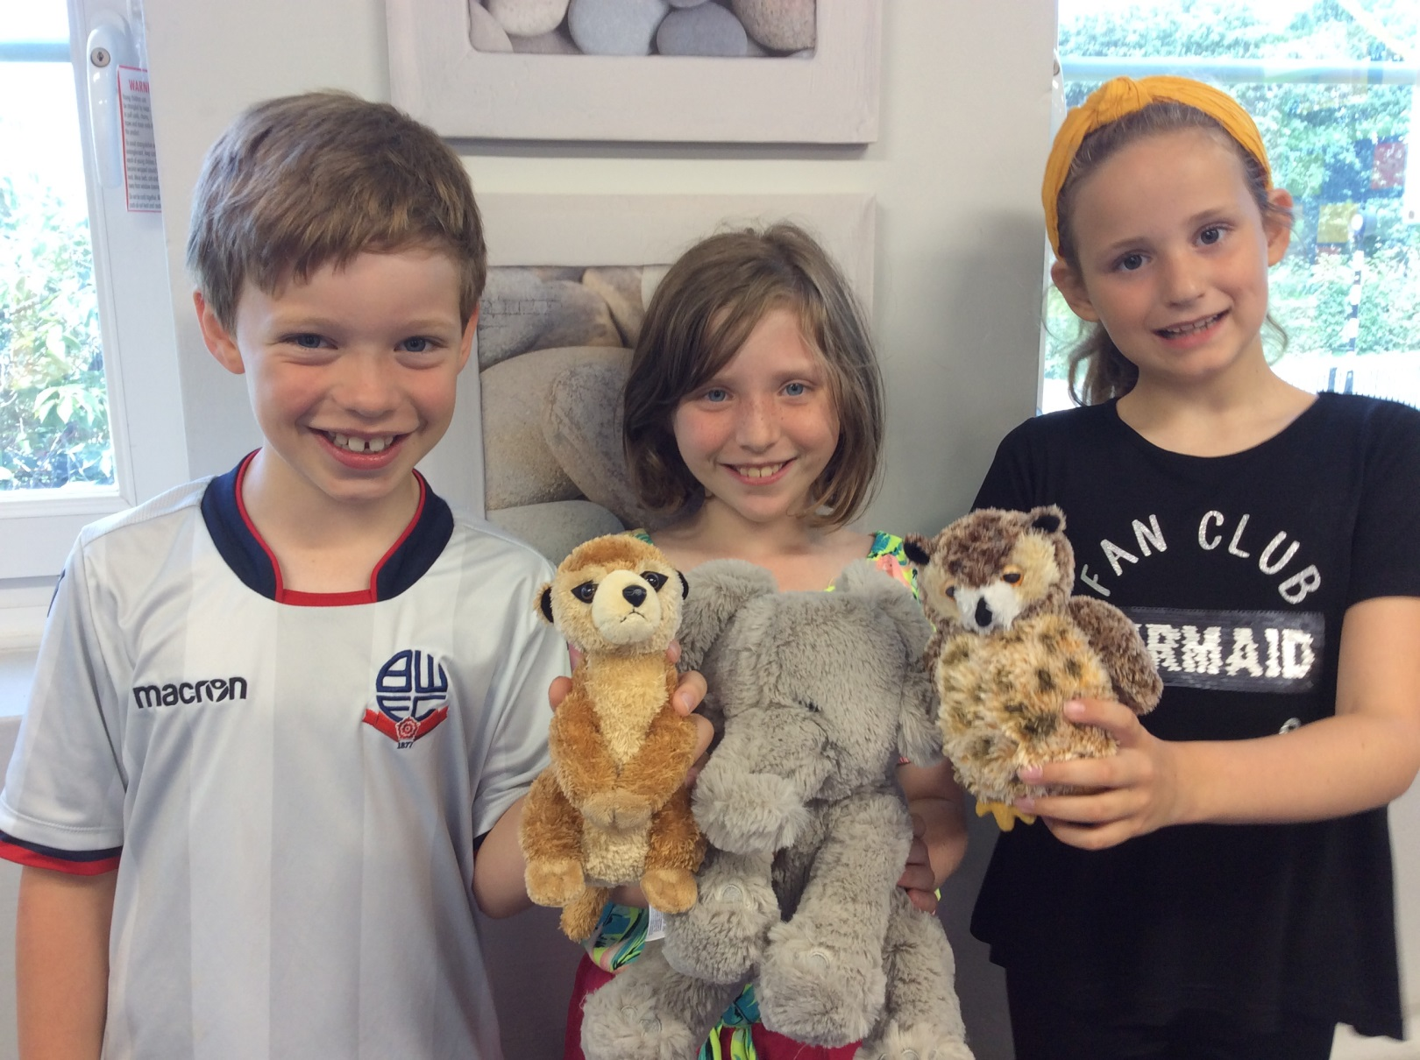
Wellbeing Animals

Slide 4
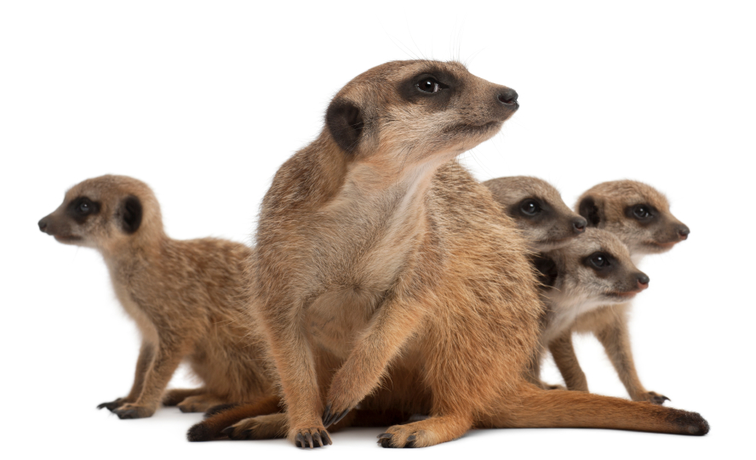
Scientific research on the brain:
Meerkat-safety radar
Elephant-memories
Owl-Communication/problem solving

Slide 5

Information given to parents:
What are the benefits?
Reduction of individual/classroom stress levels
Development of communication skills
Improved relationships
Positive learning atmosphere
Improved self -awareness and self -regulation
Improved emotional literacy
Improved confidence and self esteem
Improved attainment and motivation

Slide 6
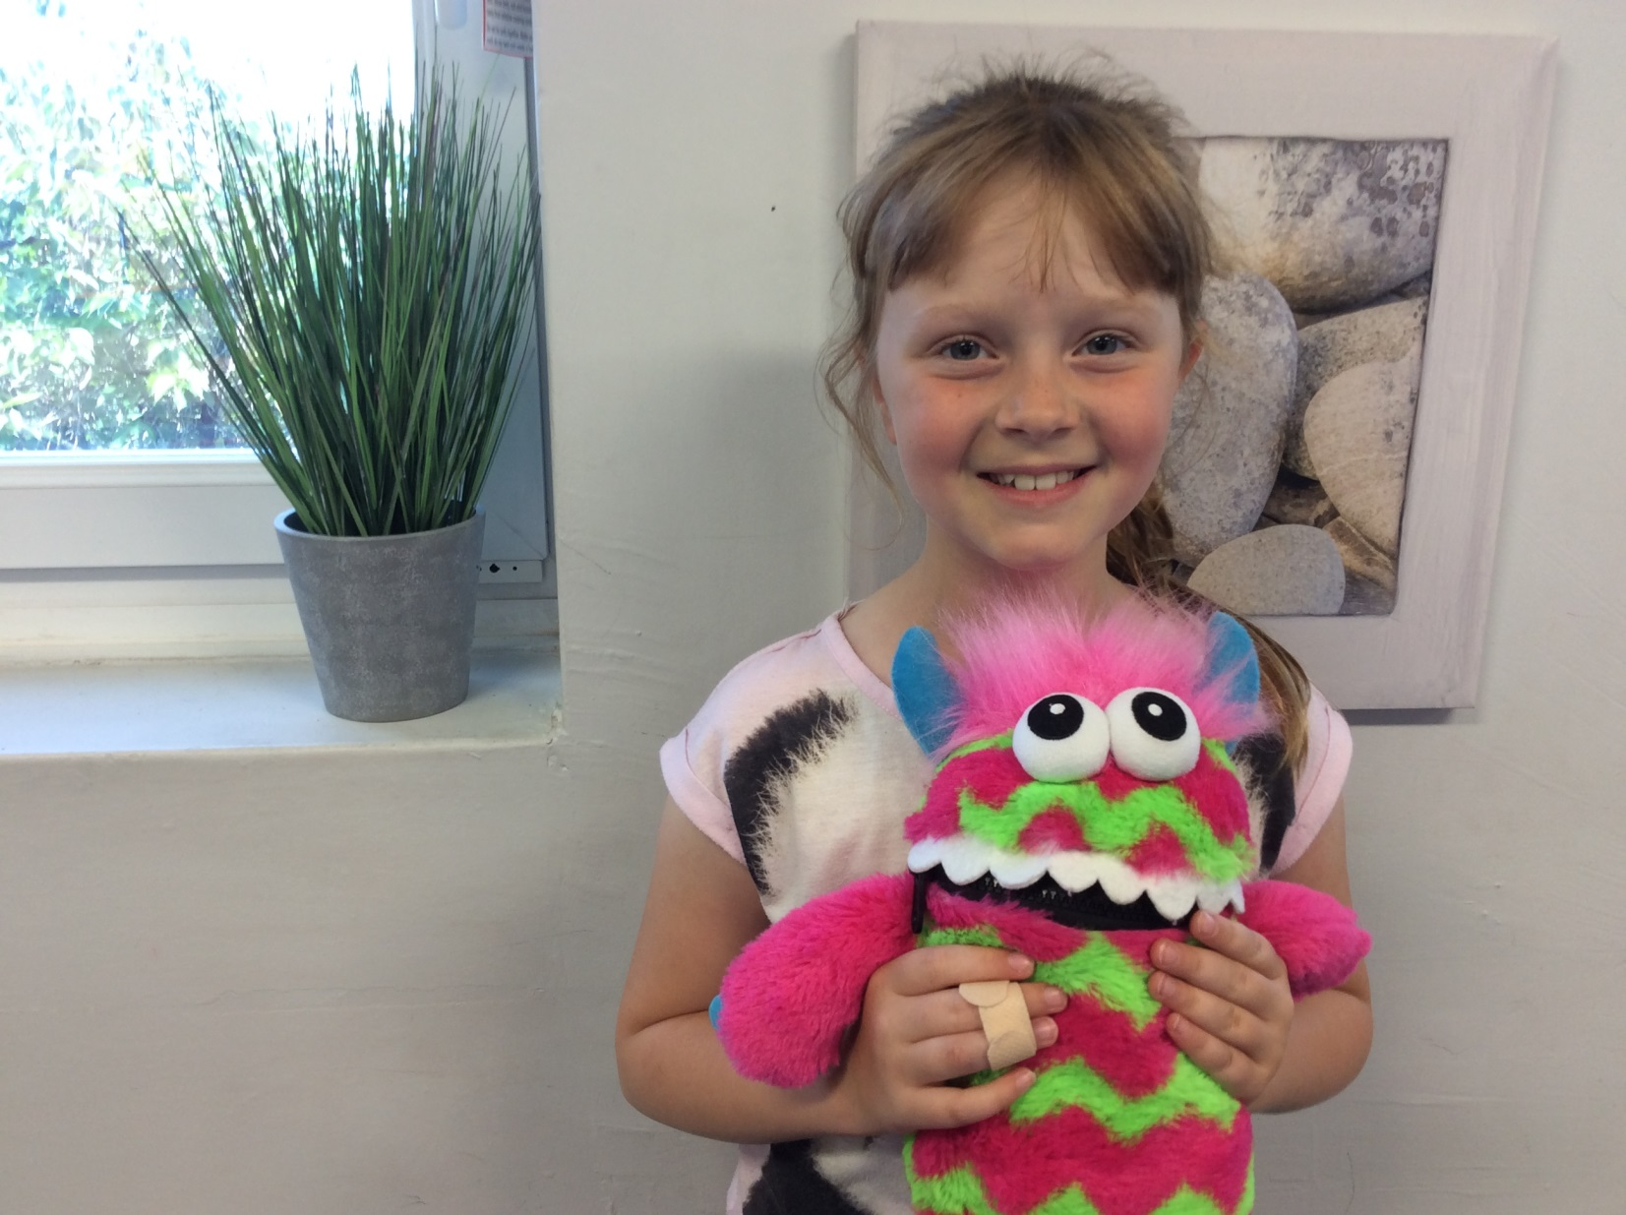
Class Worry Monsters

Slide 7
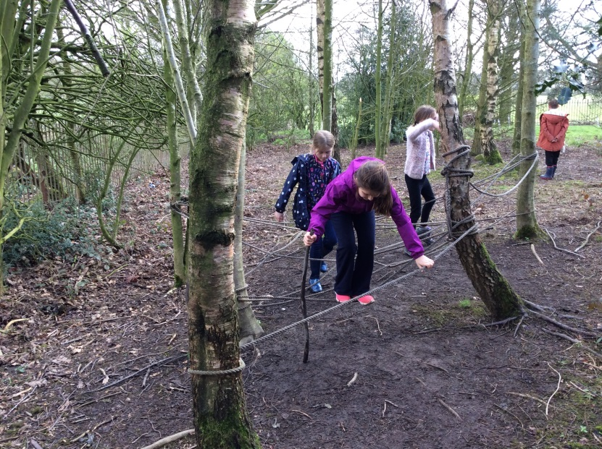
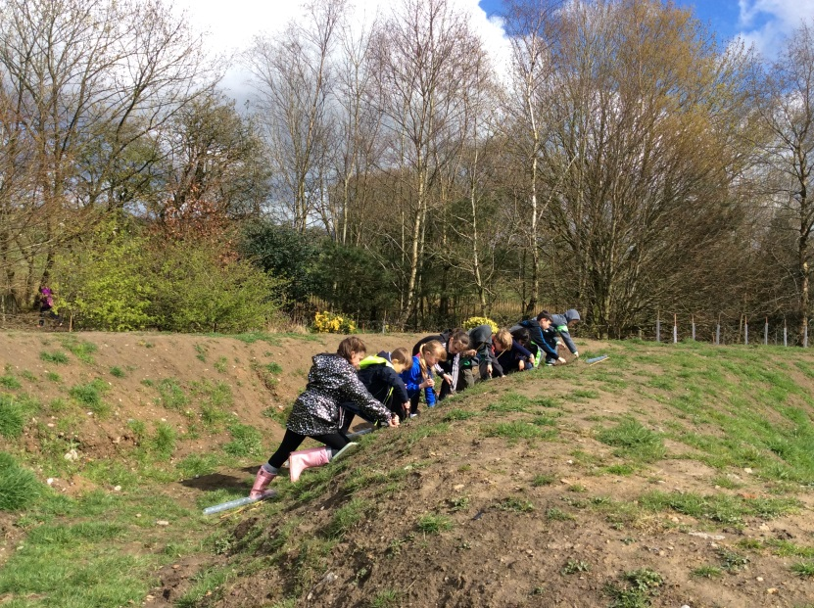
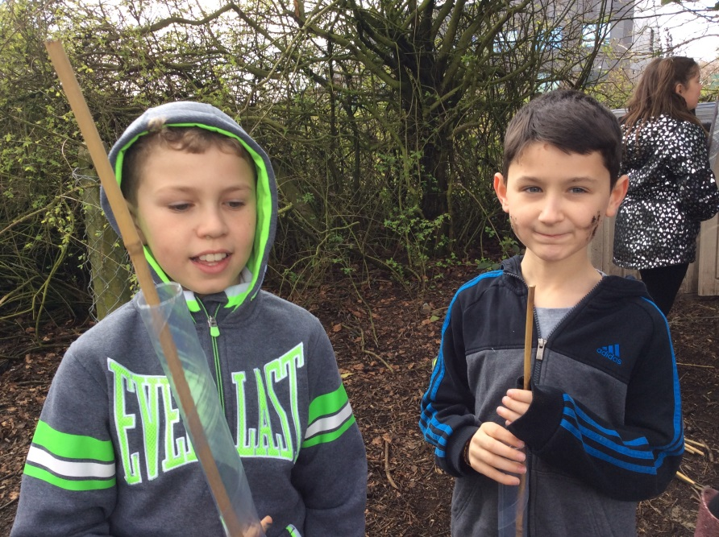
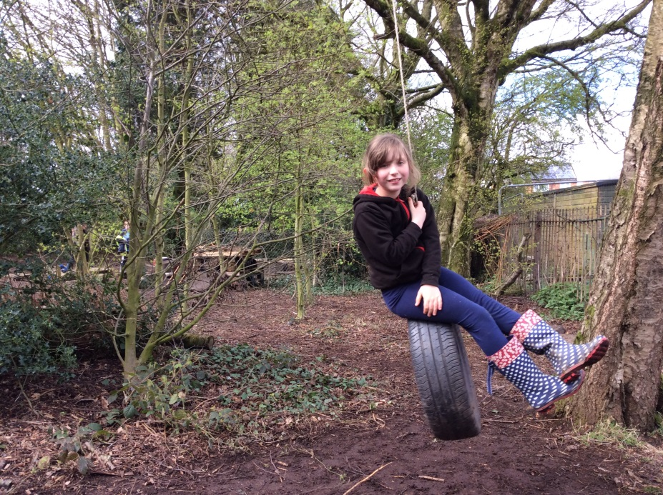
Forest School

Slide 8
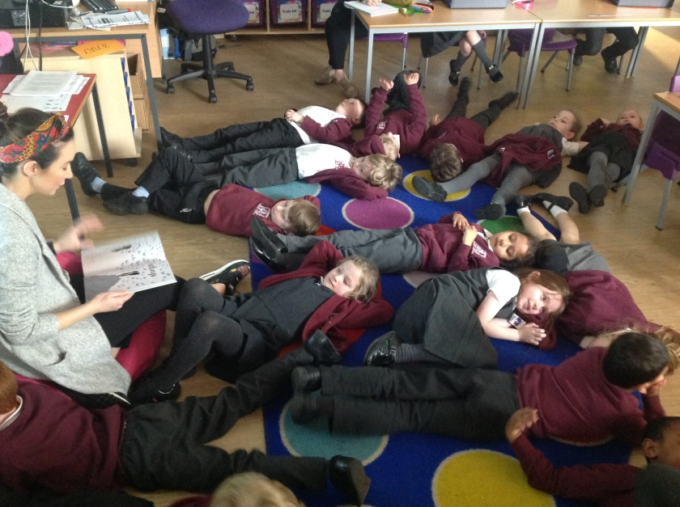
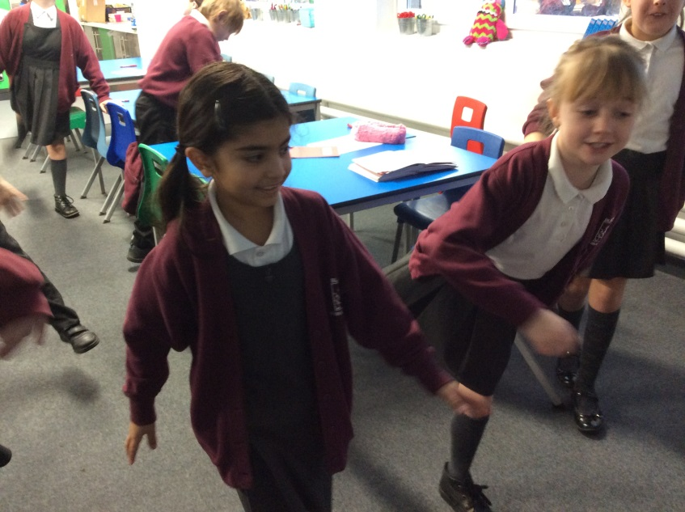
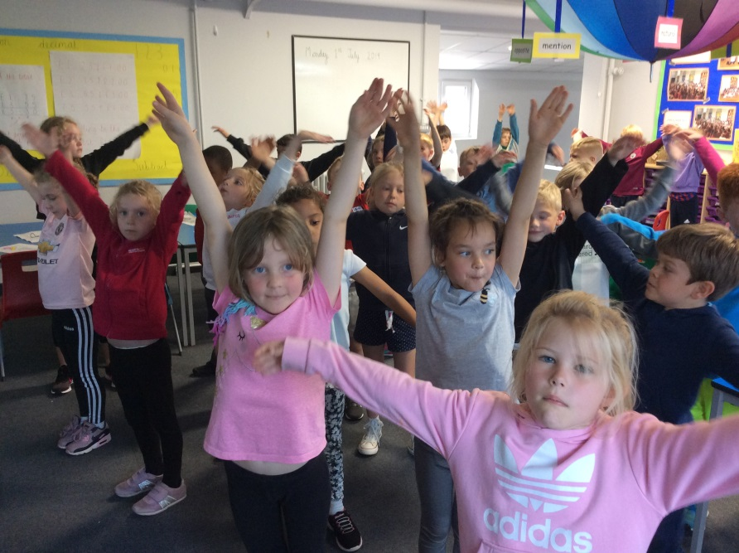
Visualisation with stories
Yoga postures
Stretching and moving

Slide 9
How can I help?
Encourage children to share how they are feeling-link to colours, emojis, pictures, scale 1-10.
Be emotionally available-bonding/relaxing together.
Focus on the positive past, present and future.
Encourage ways to relax-exercise, warm bath, quiet time before bed, limit screen time especially before bed, cuddle, shoulder/head massage, colouring/art, stories/positive thoughts.
Focused breathing-use your fingers, square breathing, loud breathing from pit of your stomach.
Diary/notebook of happiness/emotions.
Relax Kids books.
Contact school if you/your child has worries or concerns.

Slide 10
Pastoral Pop in with Mrs Wilson
Mrs Wilson will be running a lunch time activity for children to attend if they wish to.
The purpose of the session will be for children to have access to mindfulness activities, a quiet space or the opportunity to talk to Mrs Wilson if they wish to.
If you feel that you child may benefit from attending the lunch time session, please encourage them to do so.
Thursday Lunch Time 12-1pm Come along before or after your lunch to the Lower Key Stage 2 breakout area. Mrs Wilson will provide a range of wellbeing activities alongside the opportunity to talk in a safe, relaxed environment.

